Slide 1
Module-3: Unsupervised Learning:
Clustering: K-Means clustering, Hierarchical clustering, Evaluation of clustering results.
Dimensionality Reduction: Principal Component Analysis (PCA), Linear Discriminant Analysis (LDA) t-Distributed Stochastic Neighbor Embedding (t-SNE).
Association Rule Learning: Apriori algorithm, Market Basket Analysis, Evaluation metrics for association rules

Slide 2
Unsupervised Learning:
Unsupervised Machine learning is a type of machine learning where the algorithm is trained on unlabeled data, and the objective is to find patterns, relationships, or structures within the data without explicit guidance or labeled outcomes. i.e Unsupervised learning is a method we use to group data when no labels are present.
As the name suggests, unsupervised learning is a machine learning technique in which models are not supervised using training dataset. Instead, models itself find the hidden patterns and insights from the given data. It can be compared to learning which takes place in the human brain while learning new things.
It can be defined as: “Unsupervised learning is a type of machine learning in which models are trained using unlabeled dataset and are allowed to act on that data without any supervision.”
Unsupervised learning cannot be directly applied to a regression or classification problem because unlike supervised learning, we have the input data but no corresponding output data.

Slide 3
Example: Suppose the unsupervised learning algorithm is given an input dataset containing images of different types of cats and dogs. The algorithm is never trained upon the given dataset, which means it does not have any idea about the features of the dataset. The task of the unsupervised learning algorithm is to identify the image features on their own. Unsupervised learning algorithm will perform this task by clustering the image dataset into the groups according to similarities between images.
Note: Unsupervised machine learning (ML) works differently from supervised ML because it doesn't rely on labeled data to learn patterns or make predictions. Instead, unsupervised ML algorithms focus on finding hidden structure or patterns within the data without explicit guidance from predefined labels.

Slide 4
Why use Unsupervised Learning?
Unsupervised learning is helpful for finding useful insights from the data.
Unsupervised learning is much similar as a human learns to think by their own experiences, which makes it closer to the real AI.
Unsupervised learning works on unlabeled and uncategorized data which make unsupervised learning more important.
In real-world, we do not always have input data with the corresponding output so to solve such cases, we need unsupervised learning.
Semi-supervised Learning: Unsupervised ML techniques can also be combined with supervised ML in semi-supervised learning approaches. In this paradigm, a small amount of labeled data is augmented with a larger amount of unlabeled data to improve the performance of supervised models.

Slide 5
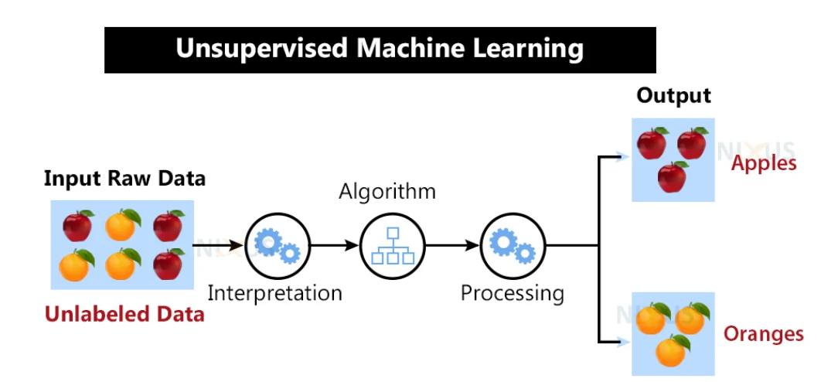

Slide 6
Here, we have taken an unlabeled input data, which means it is not categorized, and corresponding outputs are also not given. Now, this unlabeled input data is fed to the machine learning model in order to train it. Firstly, it will interpret the raw data to find the hidden patterns from the data and then will apply suitable algorithms such as k-means clustering, Decision tree, etc. Once it applies the suitable algorithm, the algorithm divides the data objects into groups according to the similarities and dissimilarities between the objects.
Working of Unsupervised learning models:
We feed the model data with no categories or outputs for training
Model interprets raw data to identify hidden patterns
Depending on data, we use suitable algorithms
Algorithm groups data

Slide 7
Disadvantages of Unsupervised Learning:
1. Unsupervised learning is fundamentally more difficult than supervised learning since it lacks comparable results.
2. The outcome of an unsupervised learning approach may be less accurate since the input data does not have labels and algorithms do not know the precise output in advance.
3. We need humans to validate the results of unsupervised learning models which convolutes the process.
4. The operations involved require a high level of computational power and also take up a lot of time.
Alternative to Unsupervised Learning:
Semi-supervised learning may be a viable alternative to unsupervised learning. It is a combination or even a min-and-match of both unsupervised and supervised learning methods. The primary benefit of this sort of training would be that it lowers errors.
For example, it will only cluster the unlabeled data that fits the clustering criteria, and it will categorize the output automatically once it has labels. This uses less computer power and takes less time.

Slide 8
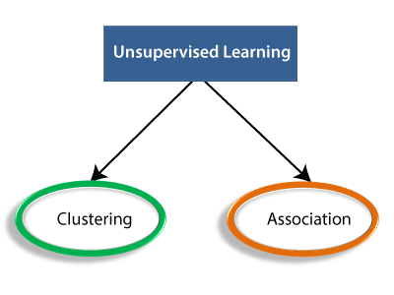
Types of Unsupervised Learning:
1. Clustering
2. Association rules
3. Dimensionality reduction.

Slide 9
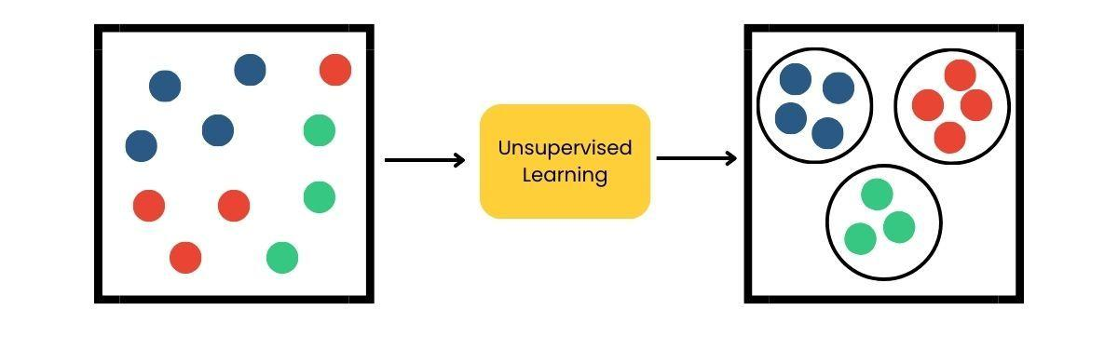
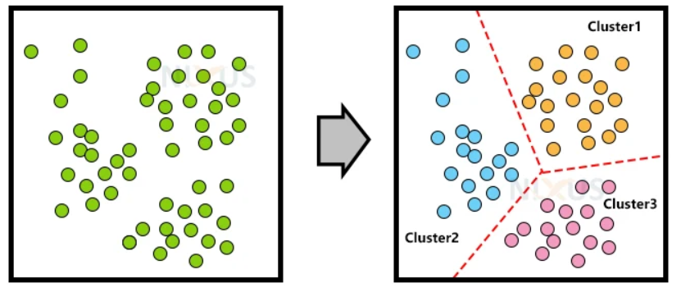
Clustering:
Clustering methods involve grouping untagged data based on their similarities and differences. When two instances appear in different groups, we can infer they have dissimilar properties.
Clustering is a type of unsupervised learning, meaning that we do not need labeled data for clustering algorithms; this is one of the biggest advantages of clustering over other supervised learning like Classification.
Clustering is the process of arranging a group of objects in such a manner that the objects in the same group (which is referred to as a cluster) are more similar to each other than to the objects in any other group.
OR

Slide 13
Module-3: Unsupervised Learning:
Clustering: K-Means clustering, Hierarchical clustering, Evaluation of clustering results.
Dimensionality Reduction: Principal Component Analysis (PCA), Linear Discriminant Analysis (LDA) t-Distributed Stochastic Neighbor Embedding (t-SNE).
Association Rule Learning: Apriori algorithm, Market Basket Analysis, Evaluation metrics for association rules

